Slide 1
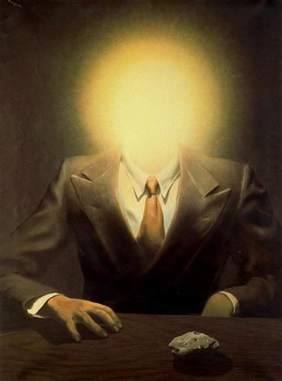
Flash/No Flash and Dark Flash Photography
René Magritte, “The Pleasure Principle”
CSC320: Introduction to Visual Computing
Michael Guerzhoy
Slides from David Capel, Yael Amsterdamer
Notes:
Show applications (alignment for hybrid image, face morphing, photo stitching) and example of transformation

Slide 2
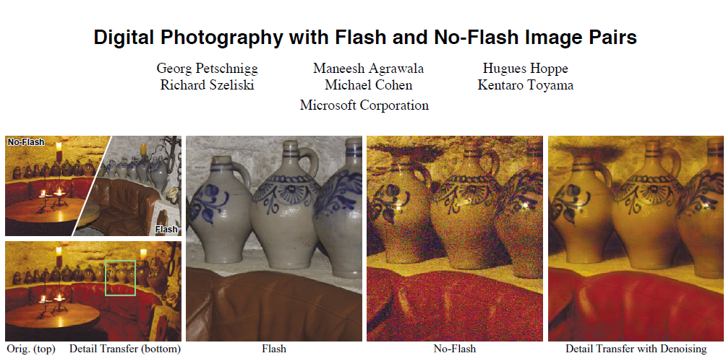
SIGGRAPH 2004
SIGGRAPH (Special Interest Group on GRAPHics and Interactive Techniques) is the premier conference where new results on graphics and related fields are presented

Slide 3
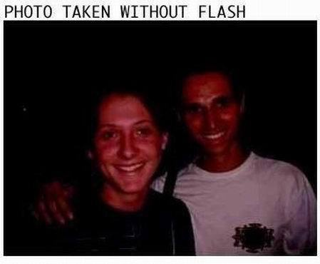
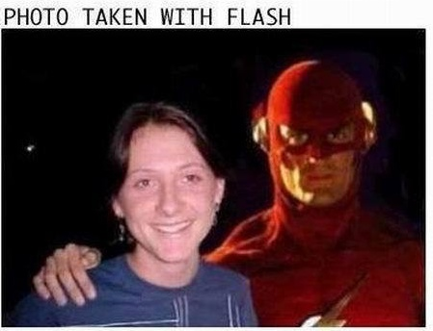
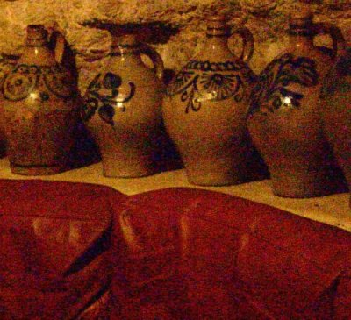
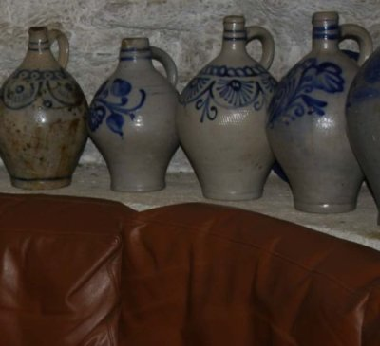
To flash or not to flash?
Natural lighting
Low signal-to-noise ratio (SNR)
Loss of details
Longer exposure – motion blur
Harsh, unnatural lighting
High SNR
More details
May cause unwanted artifacts (red eye, shadows, specularities)
Slide by Yael Amsterdamer

Slide 4

Idea: combine both to get the best of both worlds
Slide by Yael Amsterdamer

Slide 5
Acquiring a flash/no flash photo pair
Focus on the subject, lock camera settings
Capture ambient image A
Enable flash, capture flash image with minimal exposure time

Slide 6
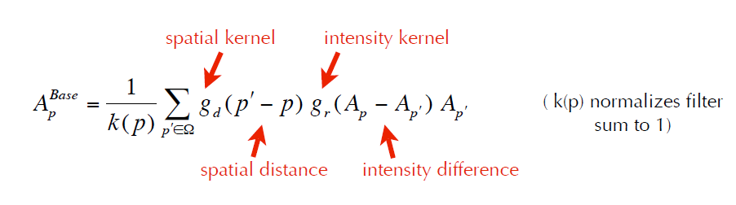
Bilateral Filter
Average pixels that are spatially close AND have similar intensities
Implement edge-preserving smoothing
Away from edges, behaves like regular Gaussian smoothing
Close to edges, the Gaussian kernel gets truncated
Effect: this smoothing does not cross edges

Slide 7
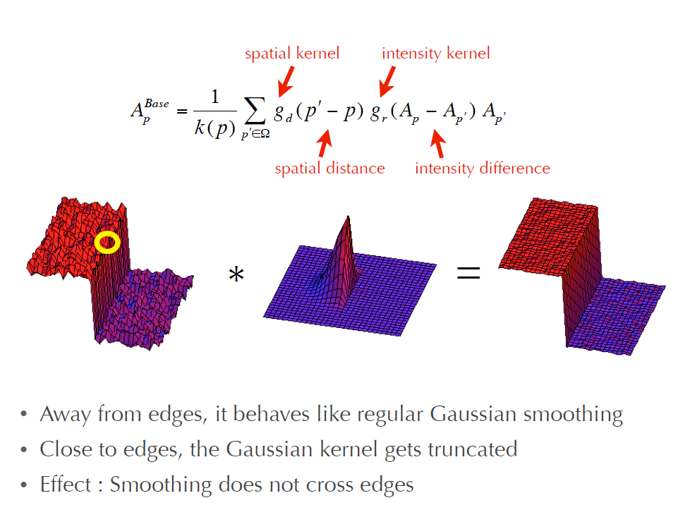

Slide 8
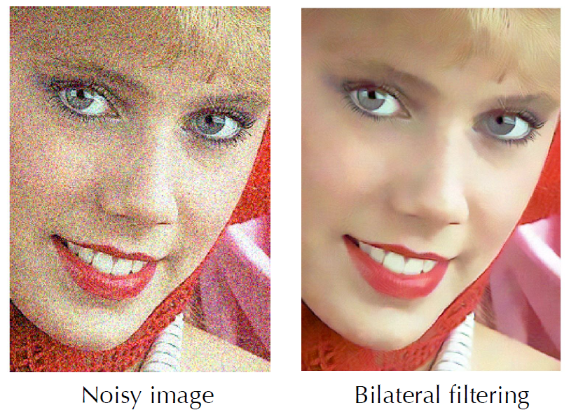
Bilateral filtering example

Slide 9
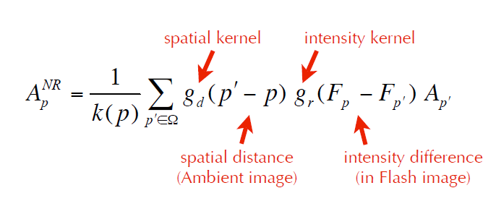
Joint Bilateral Filtering
Flash image contains much better edge information
Idea: do smoothing in the ambient image, but use flash image to provide the edge-stopping

Slide 10
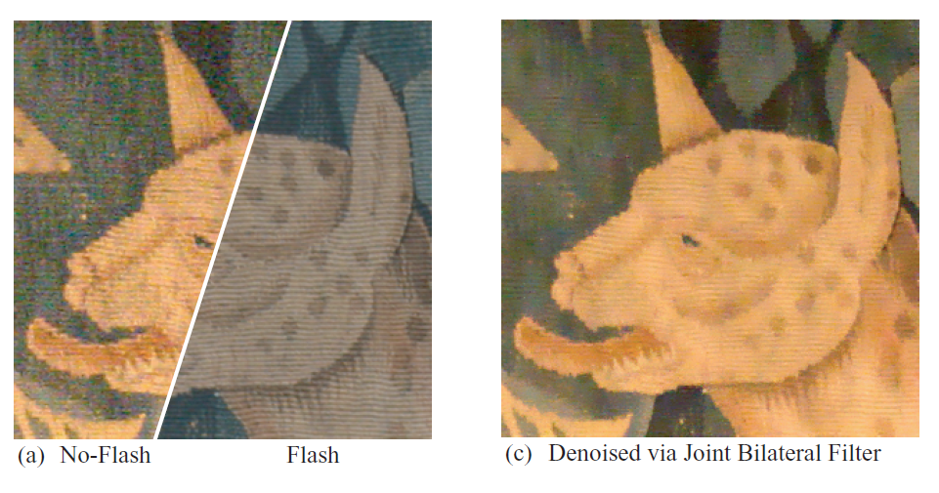
Flash/no flash Bilateral Filtering

Slide 11
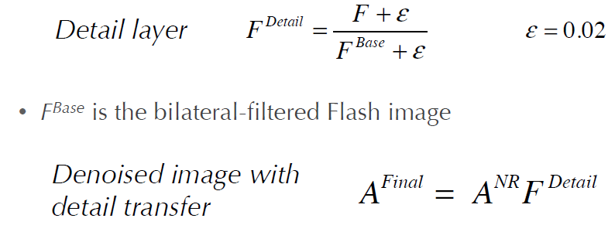
Detail Transfer
The flash image contains high-frequency content that may not be in the no-flash photo
So transfer the details from the high-frequency image

Slide 12
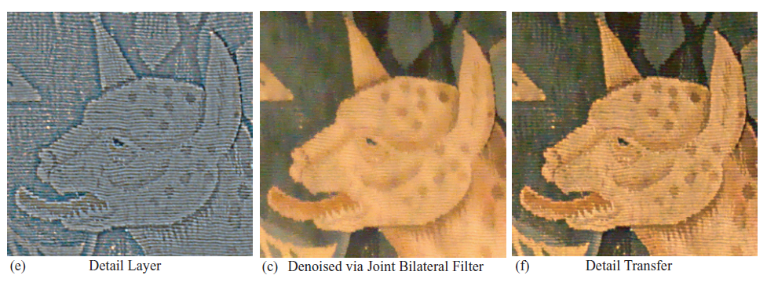

Slide 13
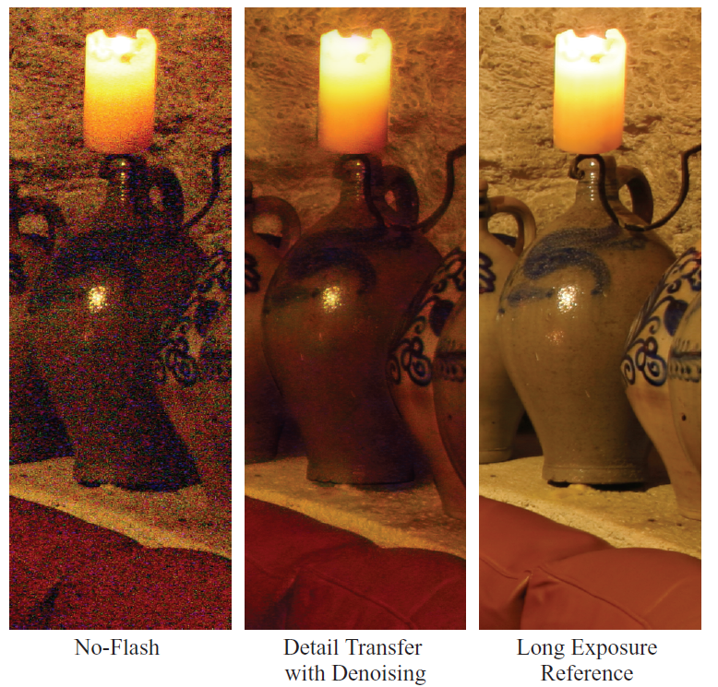

Slide 14
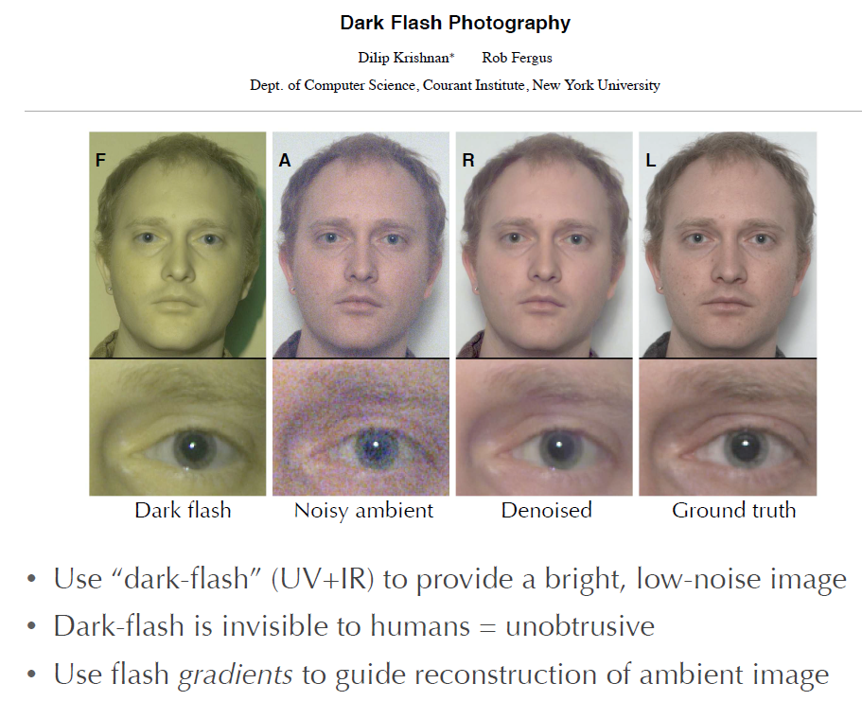
SIGGRAPH 2009

Slide 15
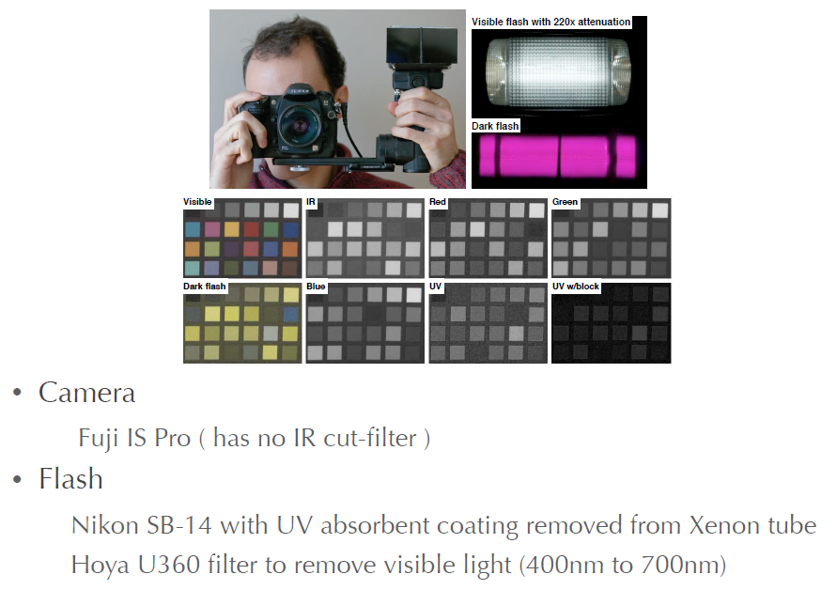
Dark-Flash Photography

Slide 16
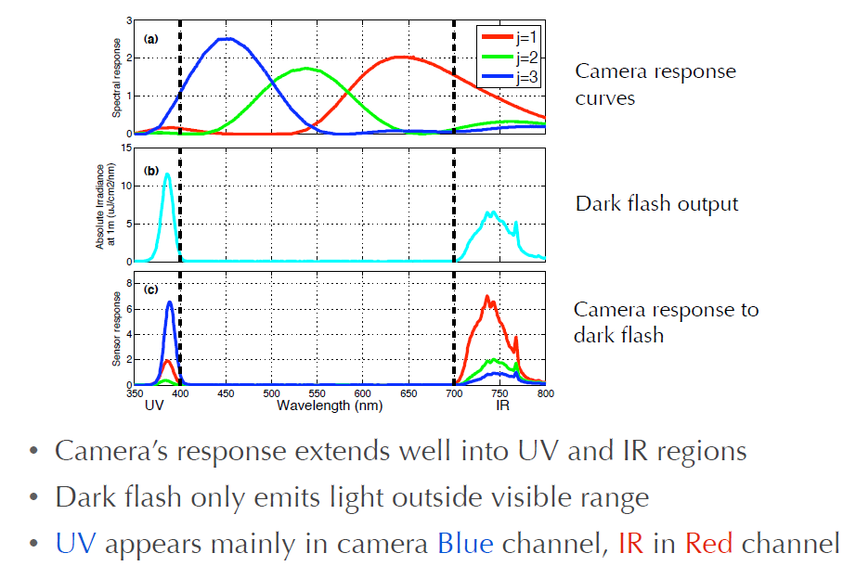
Spectral Response Curves

Slide 17
Reconstructing the Image
The dark-flash photo contains the details
The ambient photo contains the right colours

Slide 18
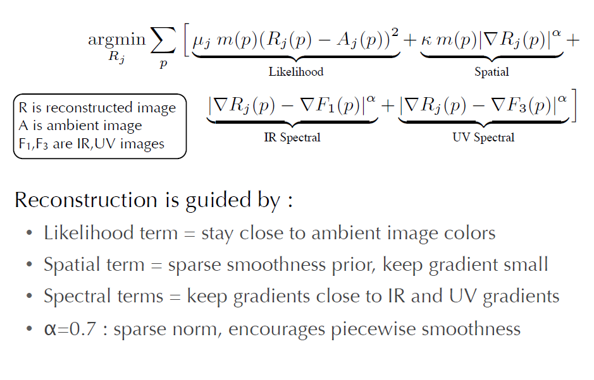
Reconstructing the Image

